Slide 1

INDIAN POPULATION CENSUS ANALYSIS
CSE3501-Social & Informational Networks
J-Component Review 1
Group Members:
Wilson Vidyut 19BCE1603
Rishank Pratik 19BCE1606

Slide 2
ABSTRACT
Past few decades has seen exponential growth in India’s population. Government has tried several schemes like (“hum do hamare do”) to control the population growth of our country. Despite the efforts, India’s population has almost reached next to China’s and is predicted to surpass it by 2022.
Our project is based on this very problem. We analyze the population based on various factors like literacy, male to female ratio, growth factors, etc. Now you may ask what is the use of doing such an analysis? Well the thing is that such analysis is the foundation of a nation’s growth and development and any government requires this data and analysis to assist them in designing schemes, plans and budgets according to the growth to control the well-being of its citizens.

Slide 3

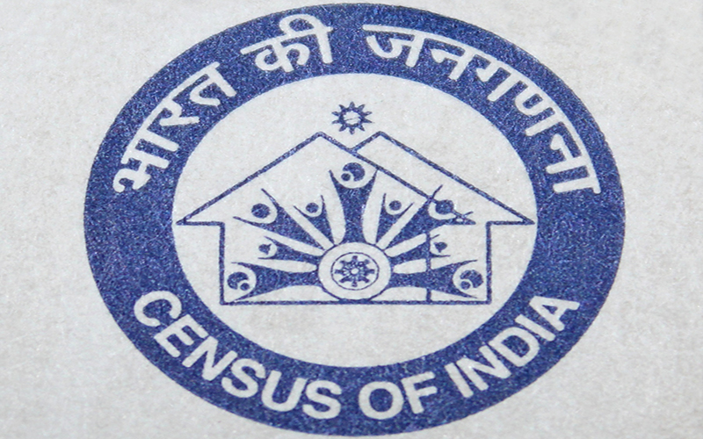

TOOLS AND DATASET USED
Python and its libraries
Panda, Matplotlib, Seaborn etc.
Data sets Used: Indian Census 2011 Kaggle dataset https://www.kaggle.com/danofer/india-census
hlpca-colnames.csv
india-districts-census-2011.csv
india_census_housing-hlpca-full.csv

Slide 4
TENTATIVE MODULES
Male to female ratio per state
Male to female literacy rate ratio per state using plot
Analyzing similarity between districts of two states
Most significant factors affecting population growth
Every religion analysis in population per state
State wise population density
Computer/internet ownership analysis per state
Visualizing them through graphs and heatmaps

Slide 5
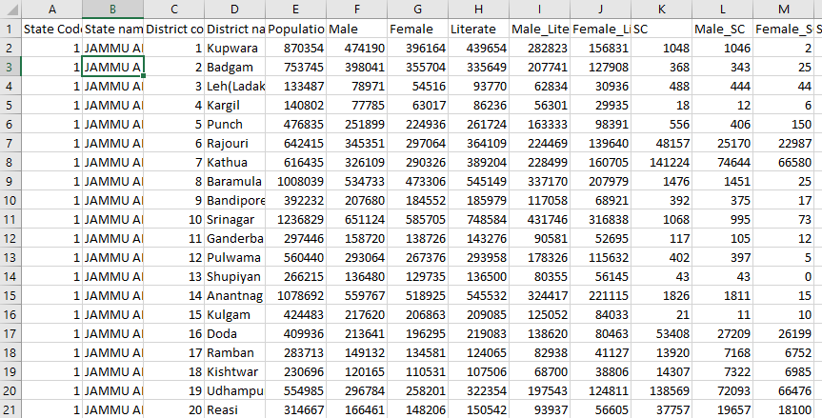
ABOUT THE DATASET & ITS PREPARATION
The dataset that we are using is the 2011 census data provided by kaggle. This data set was quite raw and we had to do some modifications to prepare it for making any analysis. We added a new column ‘state_code’ which helped us identified different states based on their code.

Slide 6
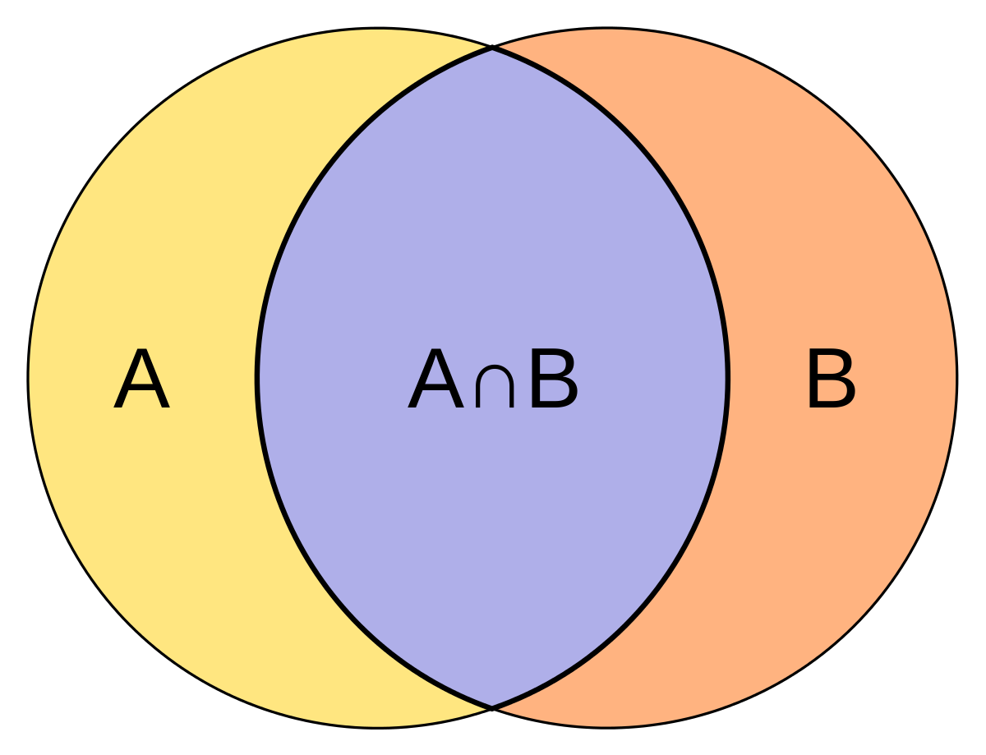

ALGORITHM
For our project we will be using Jaccard Similarity.
Jaccard Similarity measures similarities between sets. It is defined as the size of the intersection divided by the size of the union of two sets. It is a existing algorithm

Slide 7
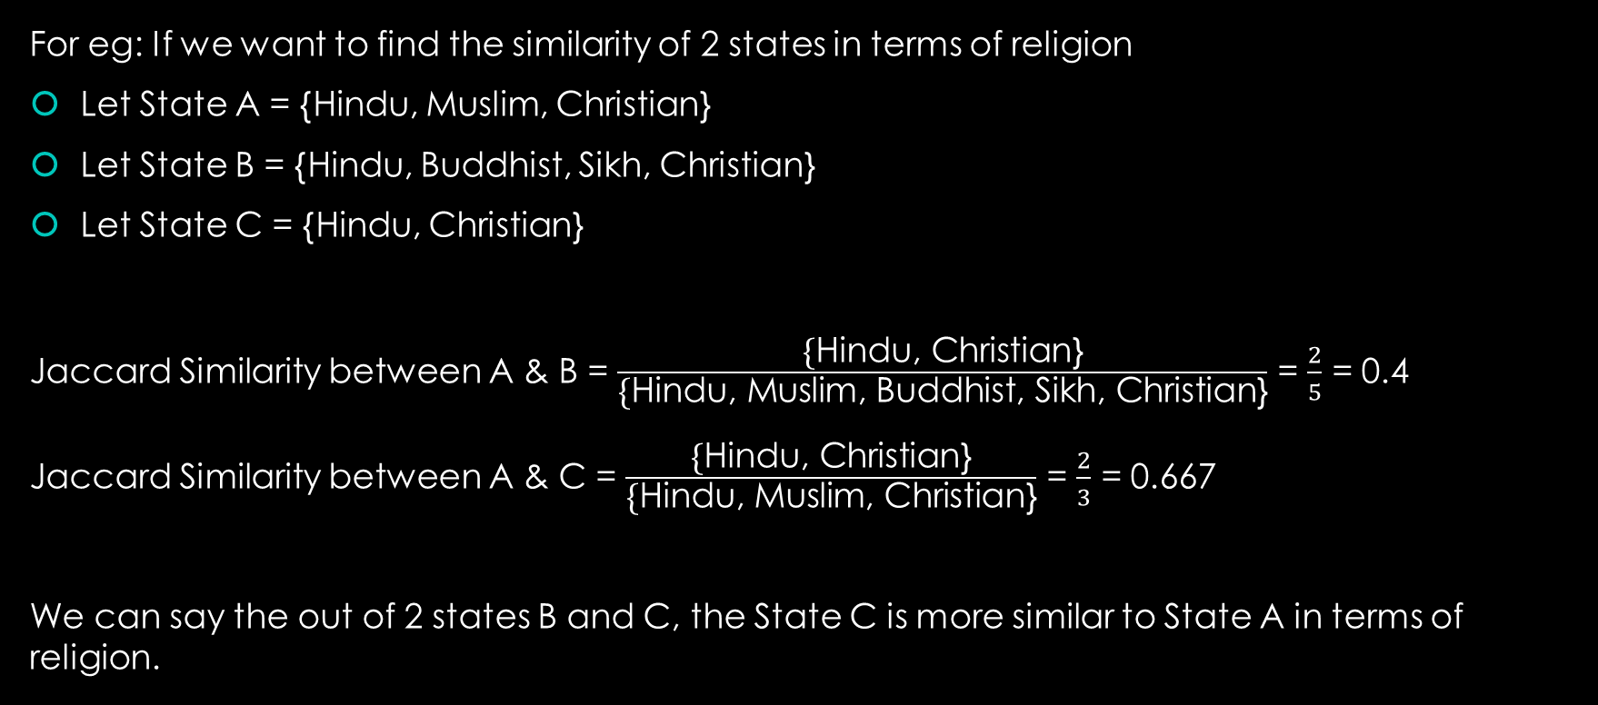
ALGORITHM
For eg: If we want to find the similarity of 2 states in terms of religion
Let State A = {Hindu, Muslim, Christian}
Let State B = {Hindu, Buddhist, Sikh, Christian}
Let State C = {Hindu, Christian}
Jaccard Similarity between A & B = $\frac{\text{\{}\text{Hindu}\text{, }\text{Christian}\text{\}}}{\text{\{}\text{Hindu}\text{, }\text{Muslim}\text{, }\text{Buddhist}\text{, }\text{Sikh}\text{, }\text{Christian}\text{\}}}$ = $\frac{2}{5}$ = 0.4
Jaccard Similarity between A & C = $\frac{\text{\{}\text{Hindu}\text{, }\text{Christian}\text{\}}}{\text{\{}\text{Hindu}\text{, }\text{Muslim}\text{, }\text{Christian}\text{\}}}$ = $\frac{2}{3}$ = 0.667
We can say the out of 2 states B and C, the State C is more similar to State A in terms of religion.

Slide 8
REASON FOR THIS ALGORITHM
Jaccard similarity is good for cases where duplication does not matter
Cosine similarity is good for cases where duplication matters while analyzing similarity
Clustering Algorithms are rejected because we are not using Machine Learning
Also, most of the data is already provided in CSV files in correct format. So not much preprocessing related algorithms, such as NLP are needed.

Slide 9
THANK YOU !
Wilson Vidyut 19BCE1603
Rishank Pratik 19BCE1606

